Slide 1
Network Compression
Instructor: Dr. Yan Yan

Slide 2
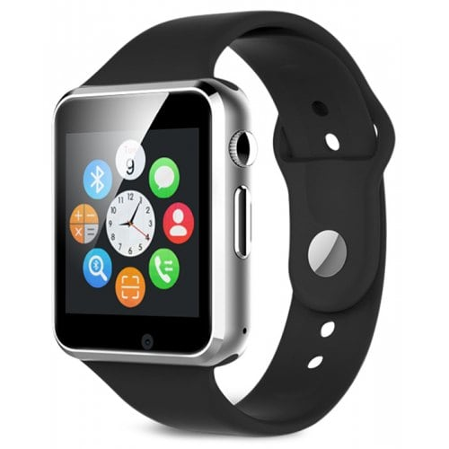
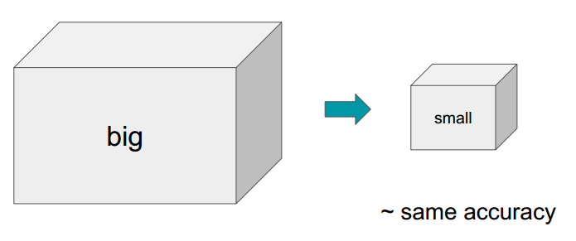
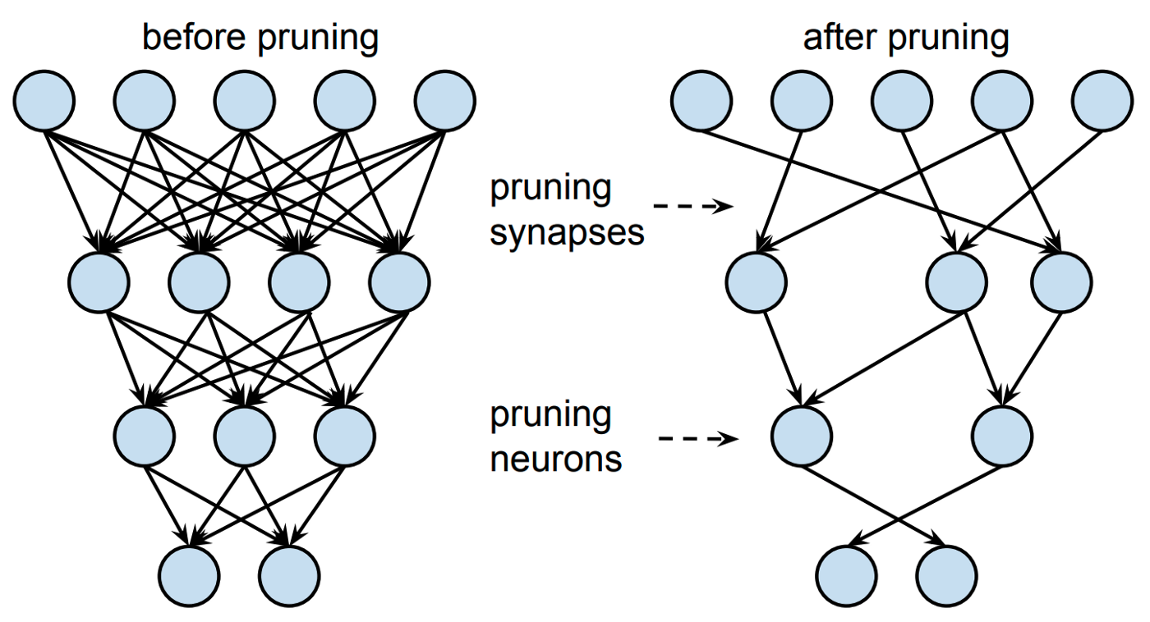
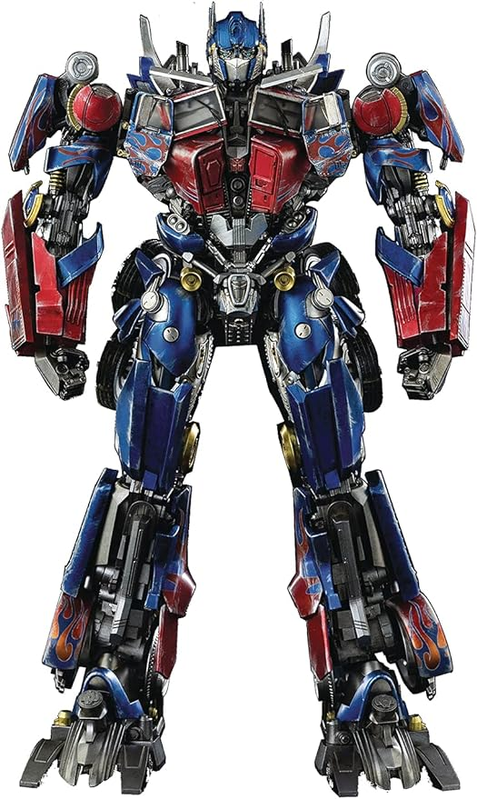
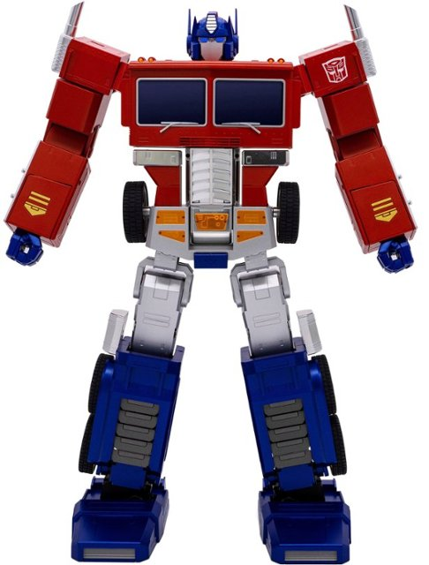
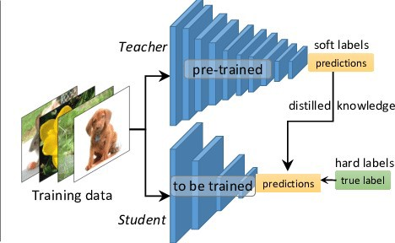
Overview
Deploying DL models in resource-constrained environments with Lower latency, Privacy, etc.
Model Compression
Set individual parameters to zero and make the network sparse.
Remove entire nodes from the network.
Model Pruning
Transfer the knowledge from a large model or set of models to a single smaller model.
Knowledge Distillation

Slide 3
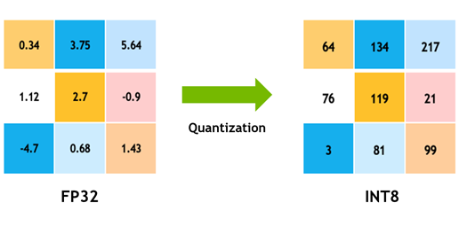
Overview
Quantization
Reduce the precision of the weights, biases, and activations such that they consume less memory.
Going from 32-bit to 8-bit, for example, would reduce the model size by a factor of 4, so one obvious benefit of quantization is a significant reduction in memory.

Slide 4
Network Pruning
Dr. Yan Yan

Slide 5
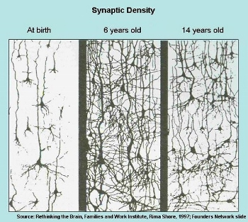
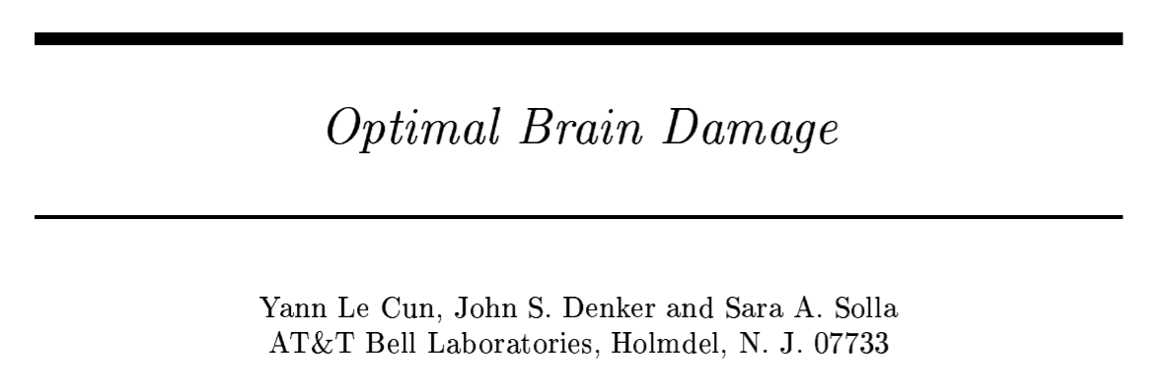
Network can be pruned
Networks are typically over-parameterized (there is significant redundant weights or neurons)
Prune them!
(NIPS, 1989)

Slide 6
Network Pruning
Pre-trained
Network
Importance of a weight:
large
absolute values, life long …
Evaluate the Importance
Importance of a neuron:
the number of times it wasn’t zero on a given data set ……
Remove
After pruning, the accuracy will drop (hopefully not too much)
smaller
Fine-tune
Fine-tuning on training data for recover
Small enough?
Don’t prune too much at once, or the network won’t recover.
Smaller Network

Slide 7
Network Pruning - Practical Issue
Weight pruning
The network architecture becomes irregular.
Prune some weights
0
Hard to implement, hard to speedup ……

Slide 8
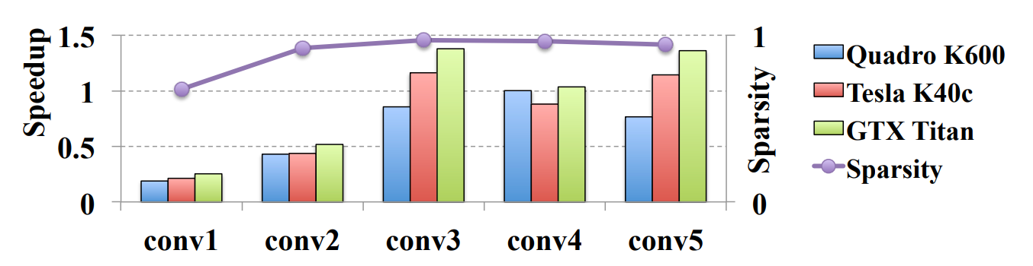
Network Pruning - Practical Issue
Weight pruning
https://arxiv.org/pdf/1608.03665.pdf

Slide 9
Network Pruning - Practical Issue
Neuron pruning
The network architecture is regular.
Prune some neurons
Easy to implement, easy to speedup ……

Slide 10
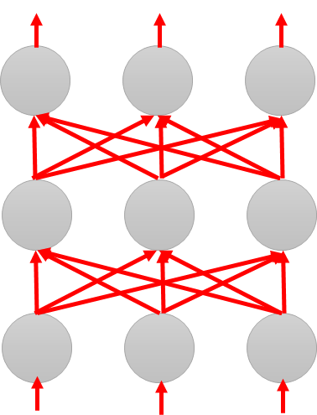
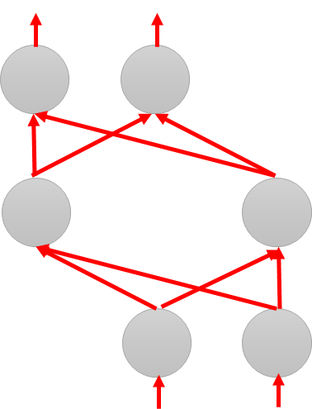
Why Pruning?
Lottery Ticket Hypothesis
Large Network
Train
Large Network
Win!
Train
Sub-
network
Sub-
network
Win!
Sub-
network
Train
Sub-
network
……
……

Slide 11
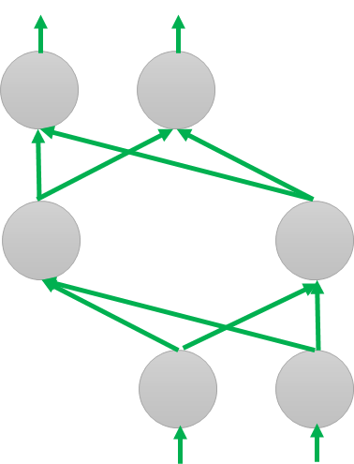
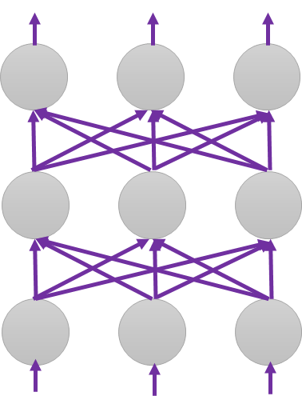
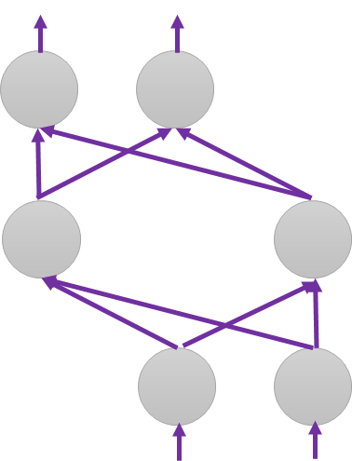
Why Pruning?
Lottery Ticket Hypothesis
Random init
Again
Original
Random init
Random init
Trained
Pruned
Random Init weights
Trained weight
Another random Init weights

Slide 12
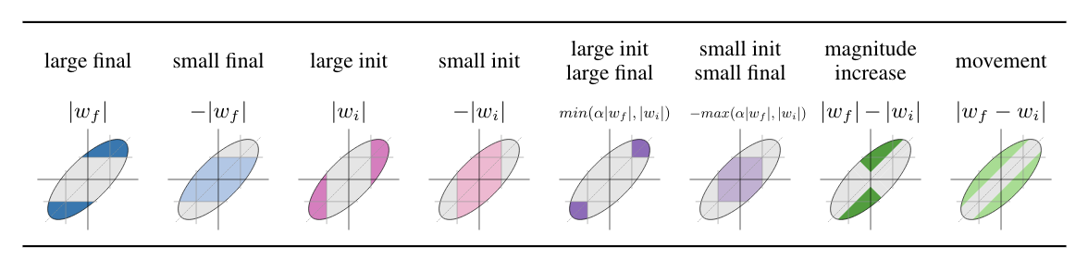

Why Pruning?
https://arxiv.org/abs/1905.01067
Lottery Ticket Hypothesis
Different pruning strategy
Deconstructing Lottery Tickets: Zeros, Signs, and the Supermask
https://arxiv.org/abs/1905.01067
“significance” of initial weights: Keeping the sign is critical
0.9, 3.1, -9.1, 8.5 ……
+$α$, +$α$, - $α$, +$α$ ……
Pruning weights from a network with random weights
https://arxiv.org/abs/1906.04358

Slide 13
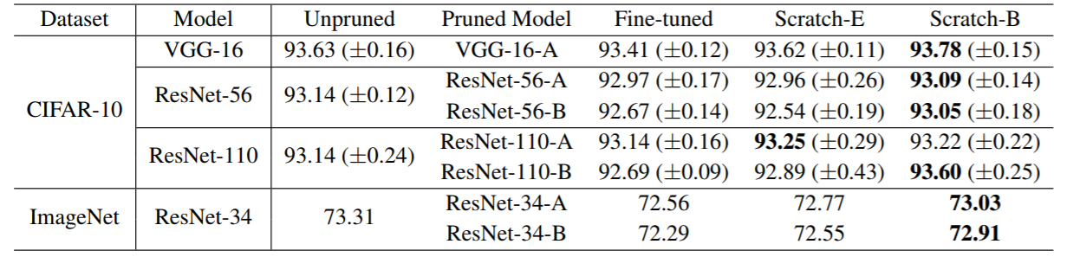
Why Pruning?
Rethinking the Value of Network Pruning
https://arxiv.org/abs/1810.05270
New random initialization, not original random initialization in “Lottery Ticket Hypothesis”
Limitation of “Lottery Ticket Hypothesis” (small lr, unstructured)

Slide 14
Knowledge Distillation
Dr. Yan Yan

Slide 15
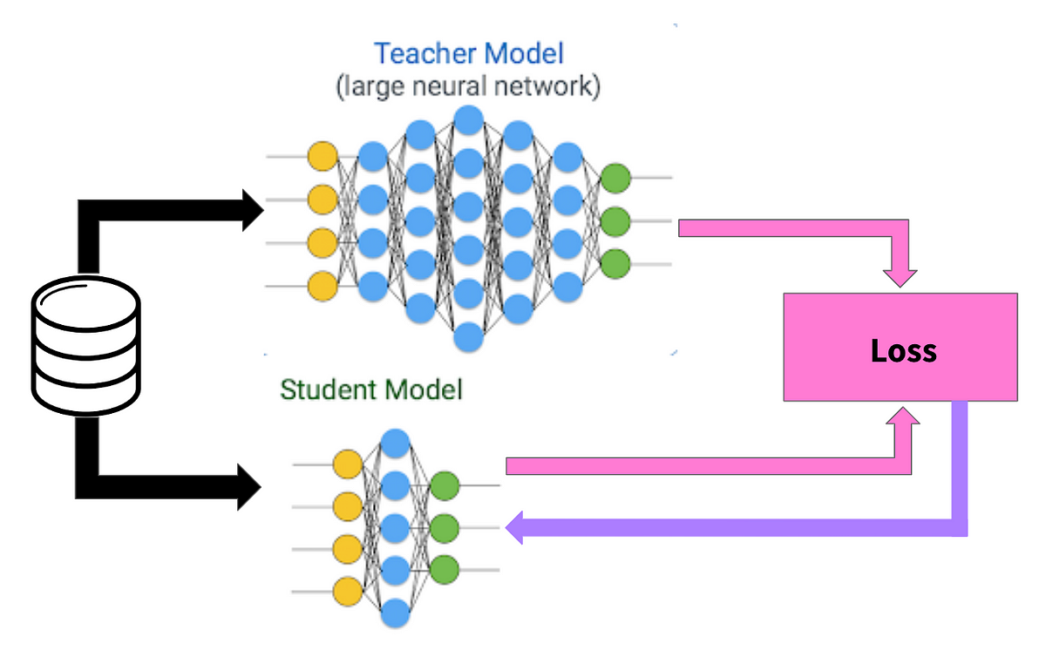

Knowledge Distillation
Model 1
Learning target
Model 2
N Networks
“1”: 0.7, “7”: 0.2, “9”: 0.1
Providing the information that “1” is similar to “7”
Cross-entropy minimization
https://arxiv.org/pdf/1503.02531.pdf
https://towardsdatascience.com/knowledge-distillation-simplified-dd4973dbc764

Slide 16
Knowledge Distillation
Model 1
Learning target
Model 2
N Networks
Ensemble
Average many models
“1”: 0.7, “7”: 0.2, “9”: 0.1
Providing the information that “1” is similar to “7”
Cross-entropy minimization
https://arxiv.org/pdf/1503.02531.pdf
https://towardsdatascience.com/knowledge-distillation-simplified-dd4973dbc764

Slide 17


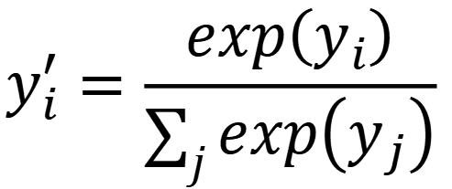












Knowledge Distillation
Temperature for softmax
$$y_{i}^{′}=\frac{exp\left(y_{i}\right)}{\sum_{j}{exp\left(y_{j}\right)}}$$
$$y_{i}^{′}=\frac{exp\left(y_{i}/T\right)}{\sum_{j}{exp\left(y_{j}/T\right)}}$$
$$T=100$$
$$y_{1}=100$$
$$y_{1}^{′}=1$$
$$y_{1}/T=1$$
$$y_{1}^{′}=0.56$$
$$y_{2}=10$$
$$y_{2}^{′}≈0$$
$$y_{2}/T=0.1$$
$$y_{2}^{′}=0.23$$
$$y_{3}=1$$
$$y_{3}^{′}≈0$$
$$y_{3}/T=0.01$$
$$y_{3}^{′}=0.21$$

Slide 18
Parameter Quantization
Dr. Yan Yan

Slide 19
Parameter Quantization
1. Using less bits to represent a value
2. Weight clustering
0.5 | 1.3 | 4.3 | -0.1
0.1 | -0.2 | -1.2 | 0.3
1.0 | 3.0 | -0.4 | 0.1
-0.5 | -0.1 | -3.4 | -5.0
weights in
a network
Clustering

Slide 20
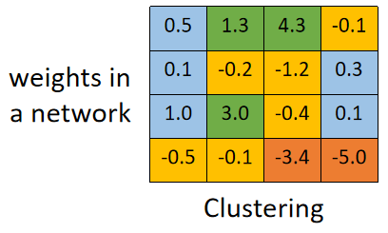
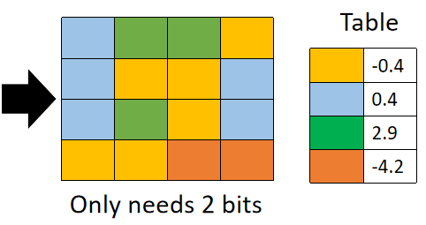
Parameter Quantization
1. Using less bits to represent a value
2. Weight clustering
3. Represent frequent clusters by less bits, represent rare clusters by more bits
e.g. Huffman encoding

Slide 21
Binary Weights
Binary Connect
Your weights are always +1 or -1
network with binary weights
network with real value weights
Negative gradient
(compute on binary weights)
Update direction
(compute on real weights)
https://arxiv.org/abs/1602.02830

Slide 22
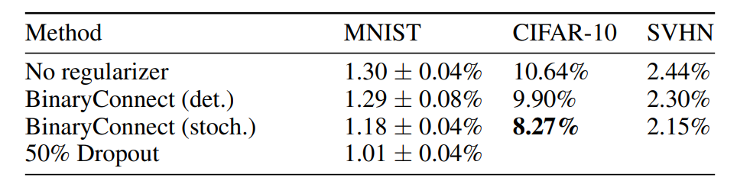
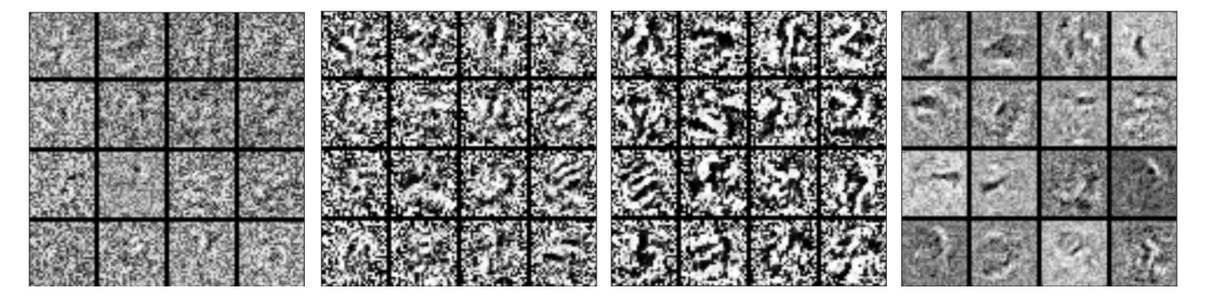
Binary Weights
https://arxiv.org/abs/1511.00363

Slide 23
Architecture Design
Dr. Yan Yan

Slide 24
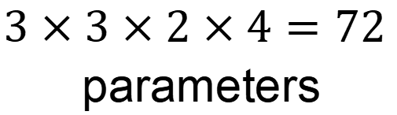
Review: Standard CNN
$$3×3×2×4=72$$
parameters
Input feature map
2 channels

Slide 25
Depthwise Separable Convolution
Depthwise Convolution
Filter number = Input channel number
Each filter only considers one channel.
The filters are $k×k$ matrices
There is no interaction between channels.

Slide 26

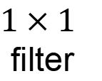

Depthwise Separable Convolution
Depthwise Convolution
$$3×3×2=18$$
Pointwise Convolution
$1×1$
filter
$$2×4=8$$

Slide 27

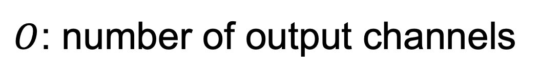


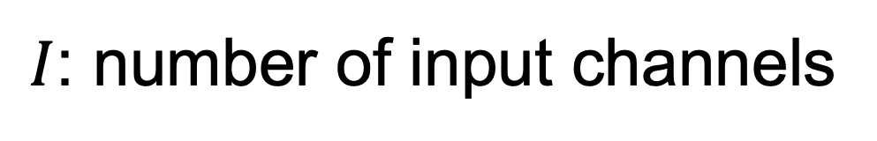






Depthwise Separable Convolution
$$k×k×I$$
$I$: number of input channels
$$k×k×I$$
$$k×k×I$$
$O$: number of output channels
$k×k$: kernel size
$$k×k×I$$
$$k×k×I+I×O$$
$$k×k×I×O$$
$$I×O$$
$$k×k×I$$
$$=\frac{1}{O}+\frac{1}{k×k}$$
$$k×k×I+I×O$$
$$(k×k×I)×O$$

Slide 28
Low rank approximation
M
M
U
W
linear
K
V
N
N
N
K
N
W
U
V
K
M
≈
M
K < M,N
Less parameters

Slide 29
18 inputs
18 inputs
9 inputs
9 inputs

Slide 30
Dynamic Computation
Dr. Yan Yan

Slide 31
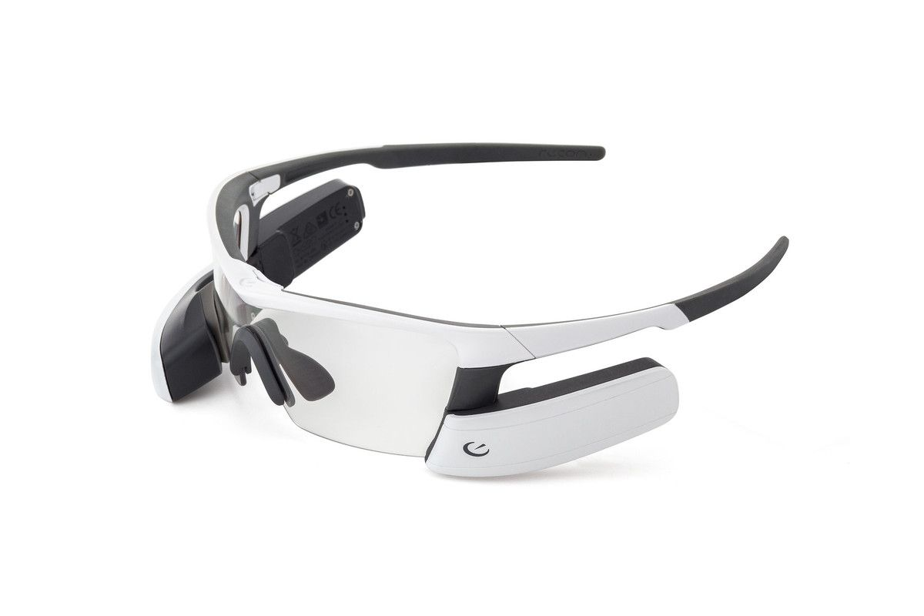
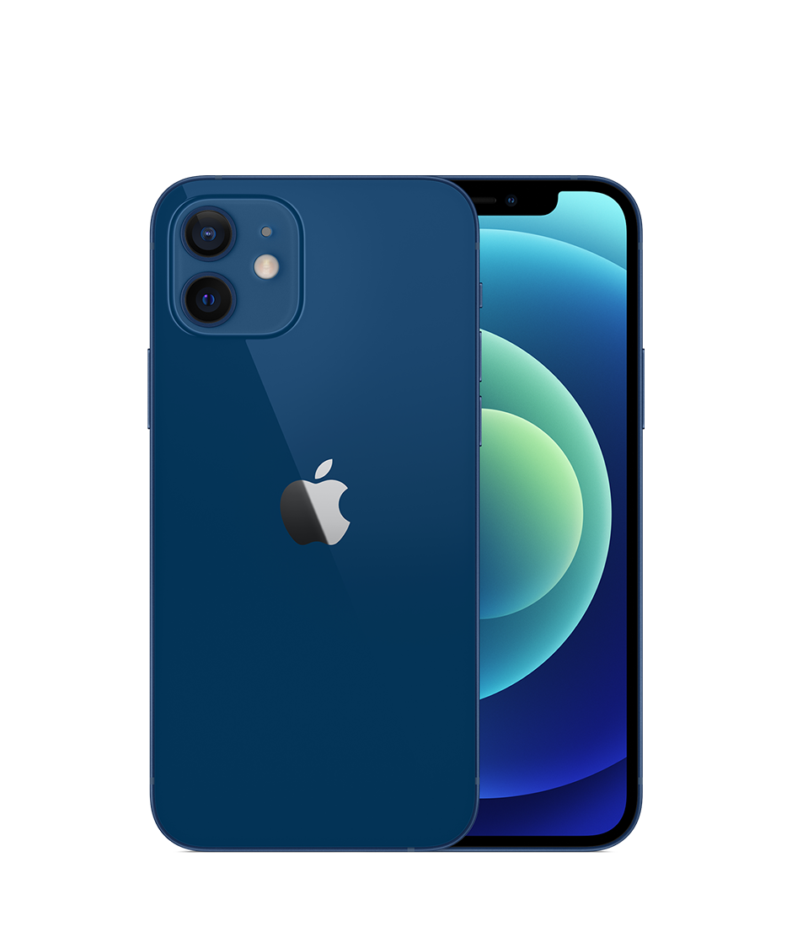
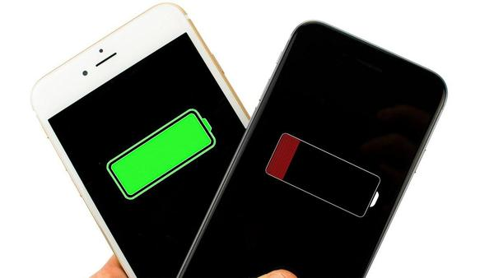
Dynamic Computation
The network adjusts the computation it need.
Why don’t we prepare a set of models?
Different devices
high/low battery

Slide 32
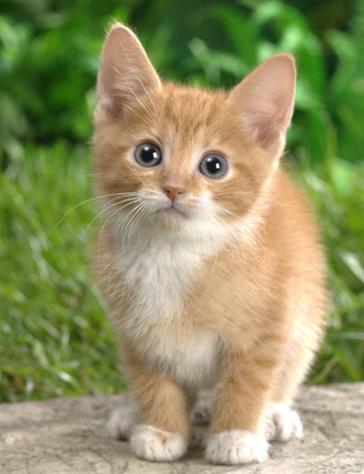








Dynamic Depth
$$L=e_{1}+e_{2}+…+e_{L}$$
high battery
Layer
1
Layer
2
Layer
L
…
$$y$$
$$\hat{y}$$
$$e_{L}$$
Extra Layer 1
Extra Layer 2
Does it work well?
Multi-Scale Dense Network (MSDNet)
$$y′$$
$$y′′$$
low battery
$$e_{1}$$
$$e_{2}$$
https://arxiv.org/abs/1703.09844
$$\hat{y}$$
$$\hat{y}$$

Slide 33
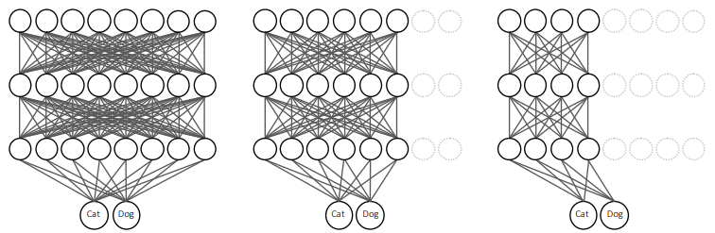


Dynamic Width
$$L=e_{1}+e_{2}+e_{3}$$
$$e_{1}$$
$$e_{2}$$
$$e_{3}$$
$$\hat{y}$$
$$\hat{y}$$
$$\hat{y}$$
Slimmable Neural Networks https://arxiv.org/abs/1812.08928

Slide 34


Computation based on Sample Difficulty
Layer
1
Layer
2
Layer
L
…
$$y$$
Simple
Stop!
$$y′$$
$$y′′$$
cat
Layer
1
Layer
2
Layer
L
…
$$y$$
cat
Difficult
Don’t Stop!
Mexican rolls
Mexican rolls
$$y′$$
$$y′′$$
Don’t Stop!
SkipNet: Learning Dynamic Routing in Convolutional Networks
Runtime Neural Pruning
BlockDrop: Dynamic Inference Paths in Residual Networks

Slide 35
Concluding Remarks
Network Pruning
Knowledge Distillation
Parameter Quantization
Architecture Design
Dynamic Computation

Slide 36
Reference
Binary Connect: https://arxiv.org/abs/1511.00363
Binary Network:https://arxiv.org/abs/1602.02830
XNOR-net: https://arxiv.org/abs/1603.05279
Knowledge Distillation https://arxiv.org/pdf/1503.02531.pdf
Do Deep Nets Really Need to be Deep? https://arxiv.org/pdf/1312.6184.pdf
SqueezeNet: https://arxiv.org/abs/1602.07360
MobileNet: https://arxiv.org/abs/1704.04861
ShuffleNet: https://arxiv.org/abs/1707.01083
Xception: https://arxiv.org/abs/1610.02357
GhostNet: https://arxiv.org/abs/1911.11907

